Slide 1
Coordinate Control:
Improving Geolocation Data to the Decimeter
Presented by: Dominik Allison, Nigel Campbell-Christie, Josh Hamlett, & Cameron Moorehead
Notes:
K nearest neighbor and logistic regression

Slide 2

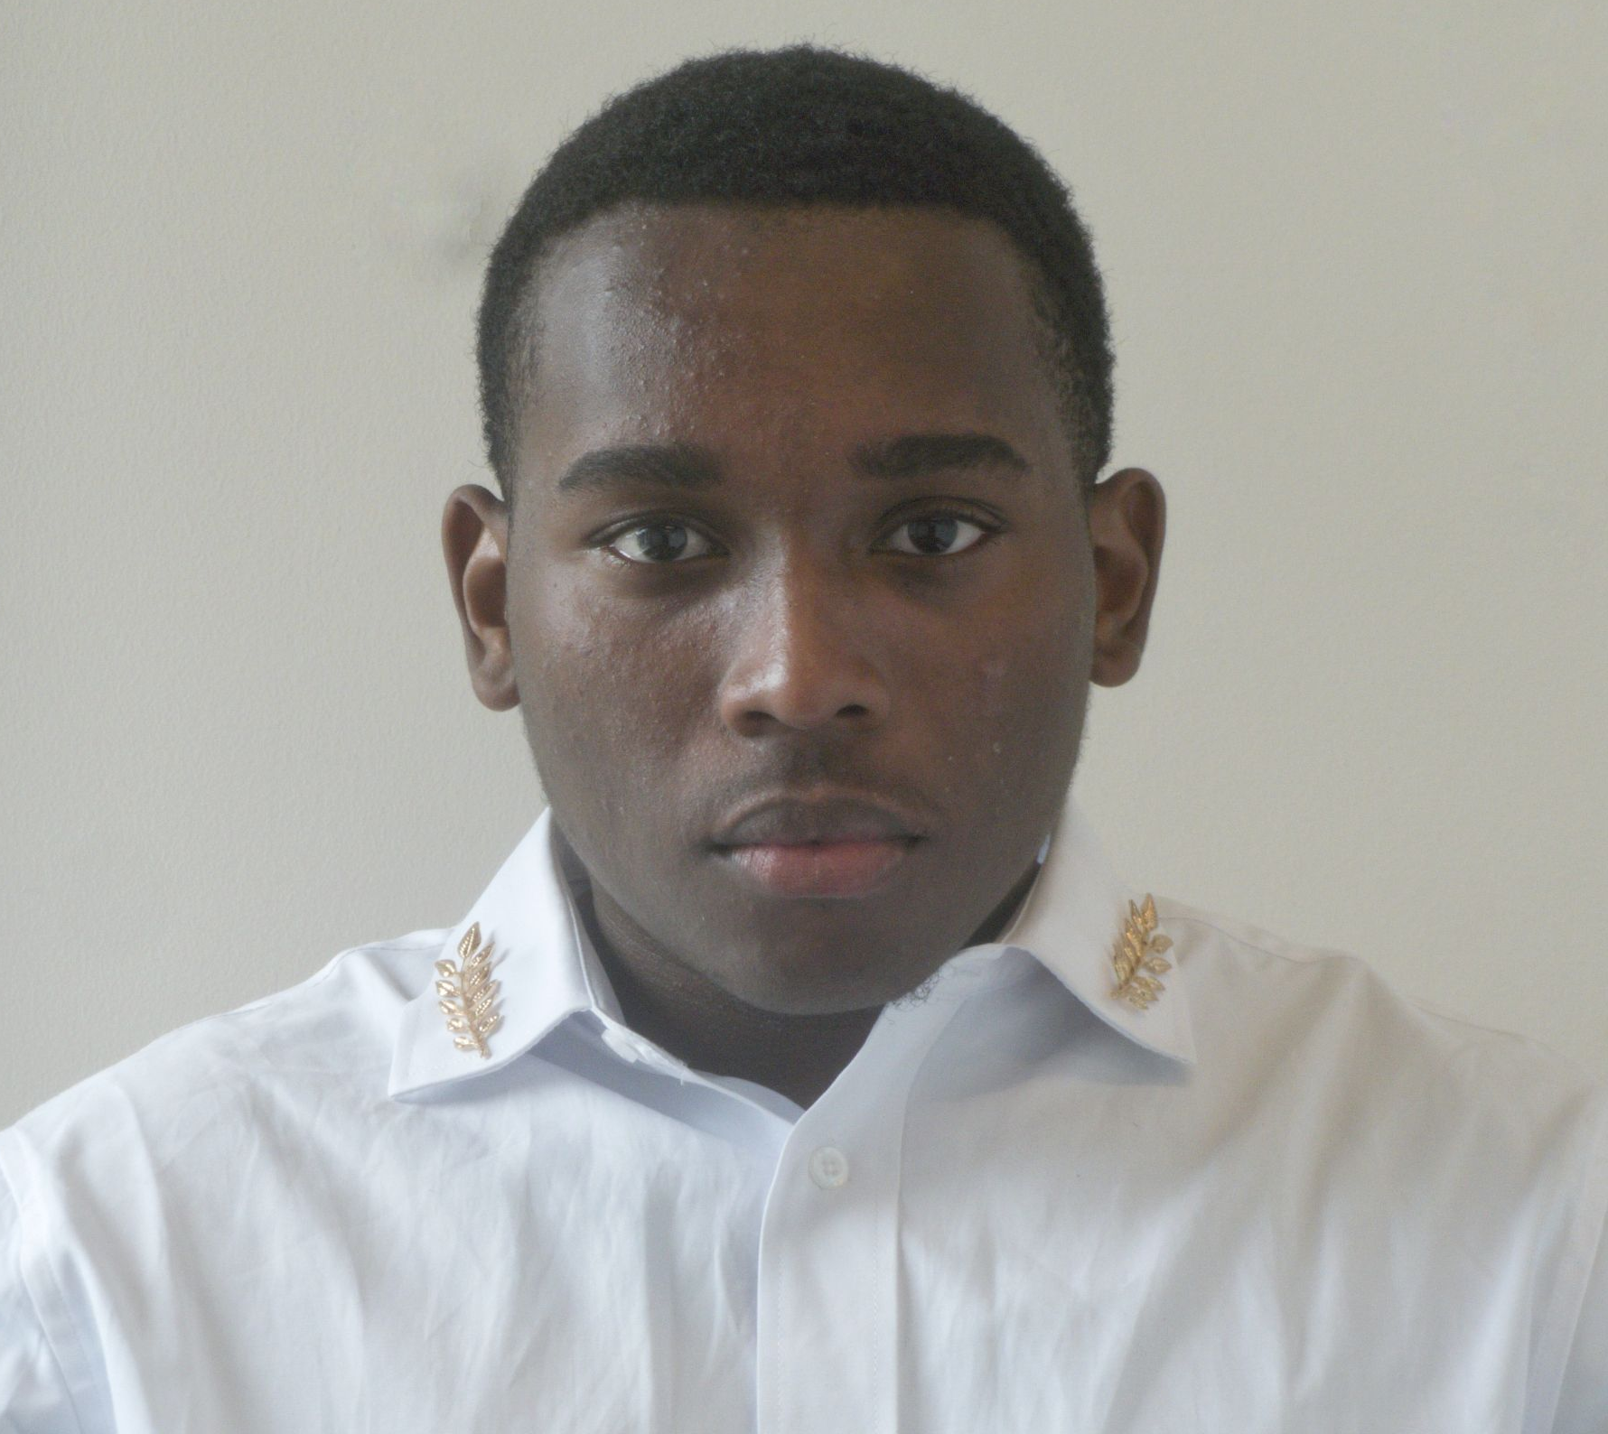

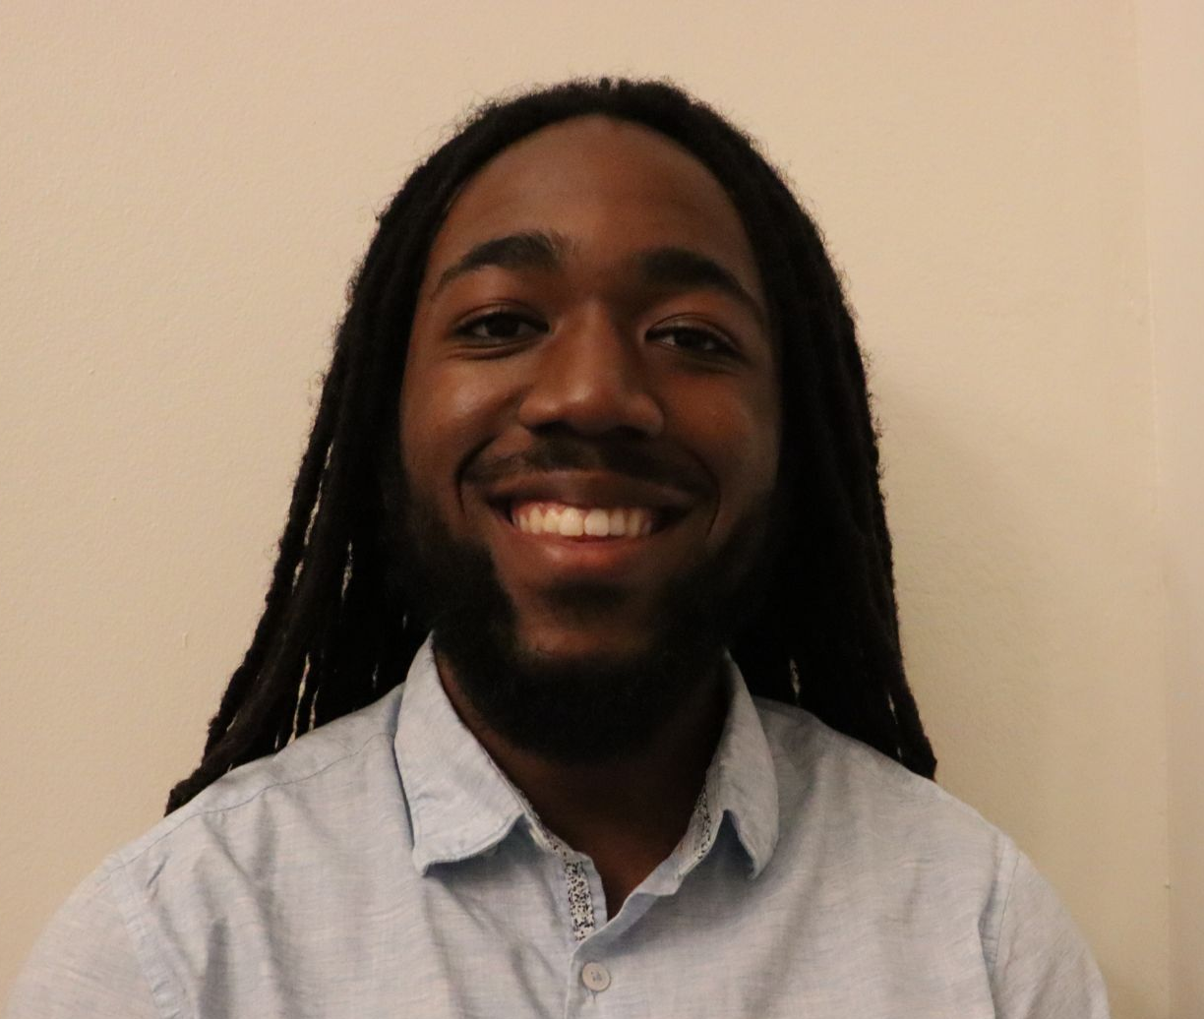
Team Coordinate Control
Dominik R. Allison
Sophomore
Electrical Engineering
Josh Hamlett
Junior
Computer Science
Cameron Moorehead
Senior
Electrical Engineering
Nigel Campbell-Christie
Junior
Industrial Engineering

Slide 3
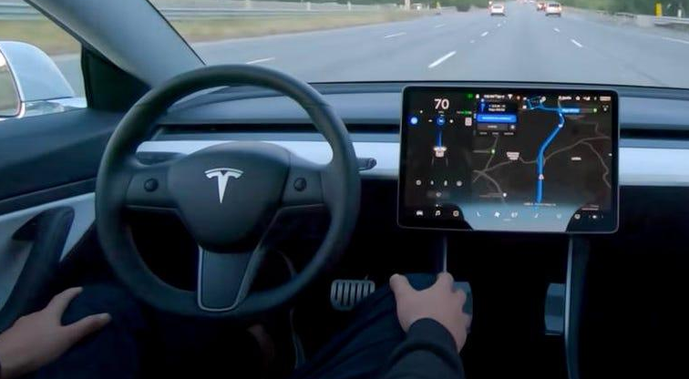
Introduction
55% of automotive businesses stated that they will have a fully autonomous fleet within the next two decades.(ii)
Why not now?
Tesla has already taken strides in becoming fully autonomous
Notes:
Why not now answer?
Global Navigation Satellite System (GNSS) provides raw signals, which the GPS chipset uses to compute a position. Current technology only offer 3-5 meters of positioning accuracy. Which is not accurate enough.
GNSS is is a general term describing any satellite constellation(a group or cluster of related things) that provides positioning, navigation, and timing (PNT) services on a global or regional basis.

Slide 4
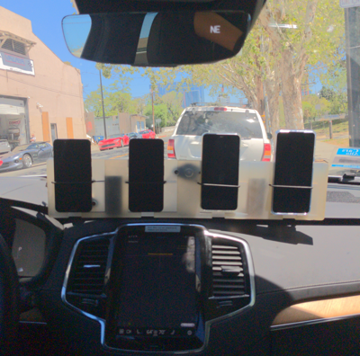
Objective of Coordinate Control
Connect the geospatial information of human behavior with mobile internet
To advance research in smartphone GNSS positioning accuracy and help people better navigate the world around them.
Improve mobile phone location accuracy to the decimeter.
Notes:
After first line: you'll use data collected from the host team’s own Android phones to compute location down to decimeter or even centimeter resolution

Slide 5
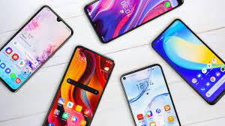

Why Did We Choose This Topic
Coming in we wanted to work on a project that would affect our daily lives.
We wanted to work on a product that would be useful to the world, not just specific types of people
Notes:
Living in today’s world, we use our smartphones all the time and location inaccuracy is one thing i notice needed better conditioned before coming into the project.

Slide 6
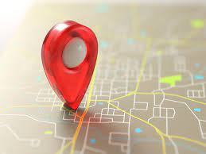
How Does this Topic Affect your Community
Discourage thieves from stealing phones
Gives phone users more accurate location data when they use their GPS
Easier to pin a location

Slide 7
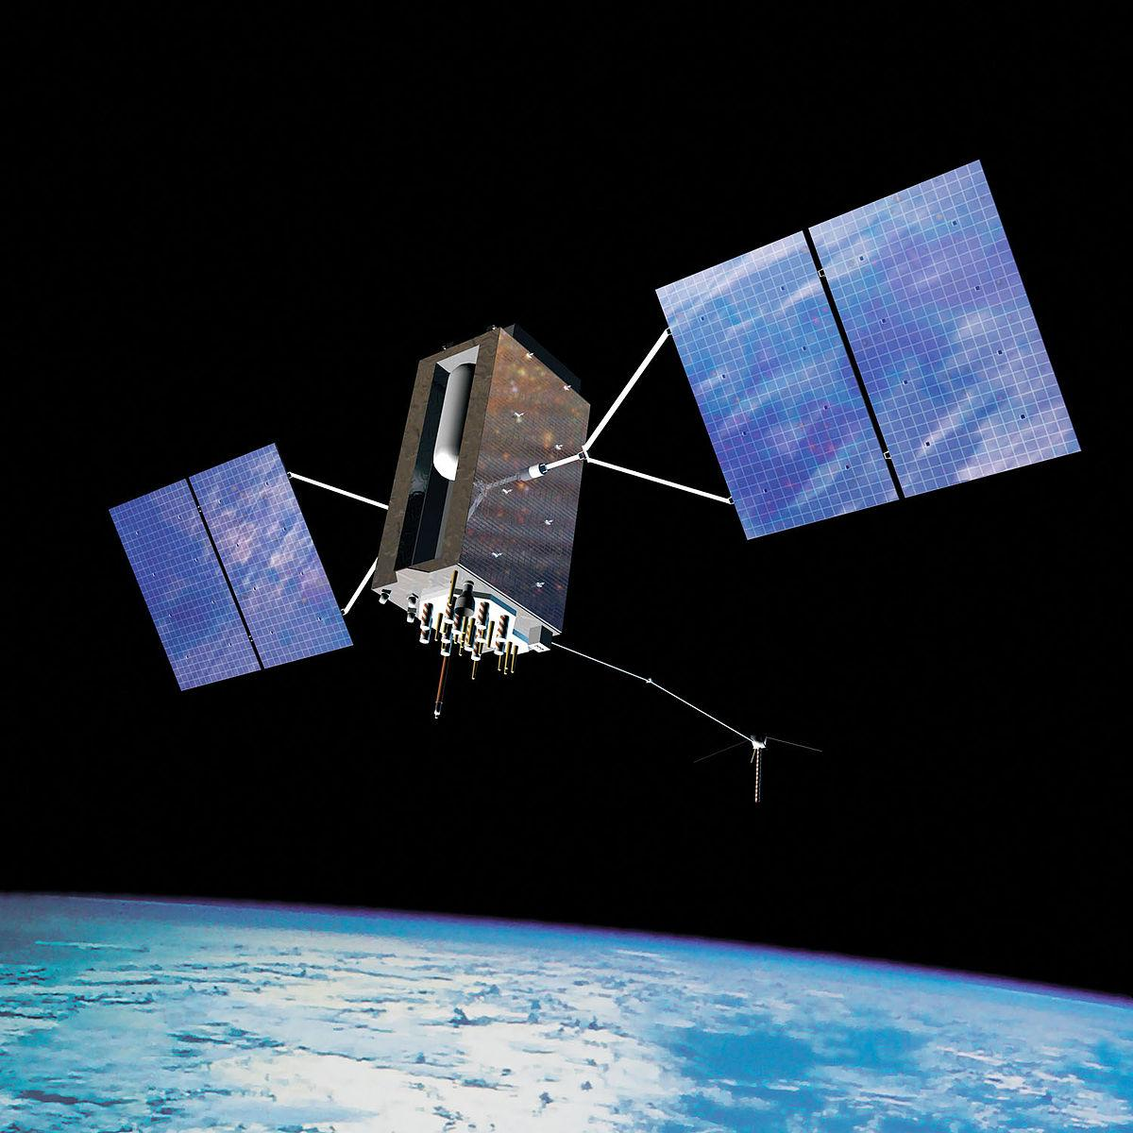
Global Navigation Satellite System (GNSS)
Global Navigation Satellite System (GNSS) provides autonomous geo-spatial positioning with global coverage
We were provided with data that used raw data signals derived by satellites within the (GNSS)
Using the data from these satellites allowed us to gain access to phone coordinates from San Francisco to San Jose California.
Notes:
What is Global Navigation Satellite System?
GNSS is is a general term describing any satellite constellation(a group or cluster of related things) that provides positioning, navigation, and timing (PNT) services on a global or regional basis.

Slide 8
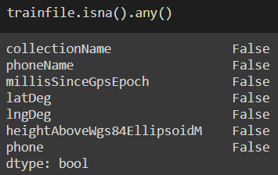
The Beginning of the Process
After acquiring the data set, we checked the training datafile to see if there was any missing data.
This was crucial to the process of training the model because missing data can cause miscalculation and error.

Slide 9
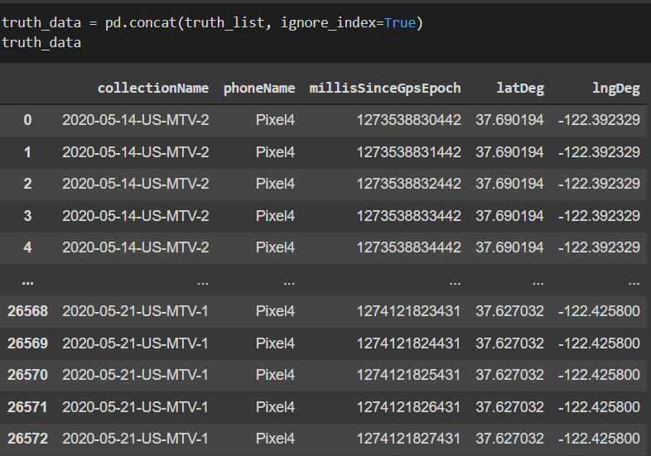
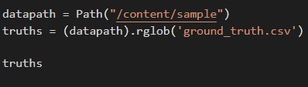
Acquisition of Truth Data
We then accessed the ground truth data file paths, and we went through all of those paths to get the data and build a dataframe with the referenced columns.

Slide 10


Description of Model 1
We used a train test split and linear regression to make a model that predicts the true location of the phone in contrast to the phone’s current location data.

Slide 11
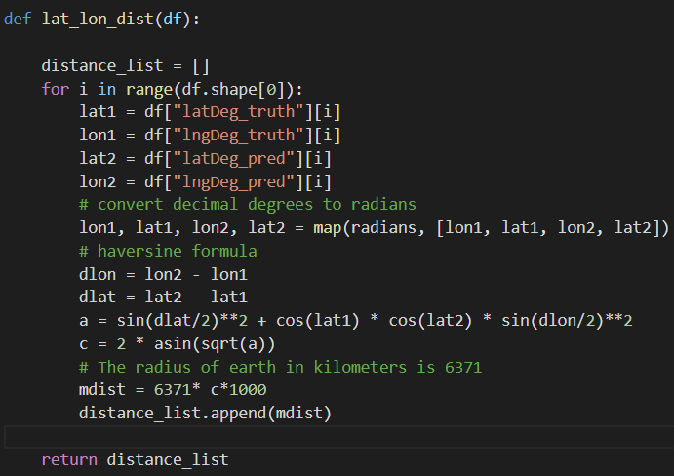
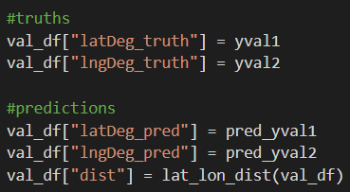
Calculation of Longitude and Latitude distance
We use this function to go through the range of datafile values to get the the distance of longitude and latitude from the datafile using the haversine formula

Slide 12
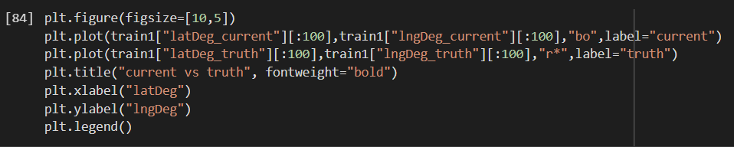
More of the Procedure of what we did?
We plotted the model with the plots representing the current phone location represented by blue circles, and red stars representing the predicted truth data

Slide 13
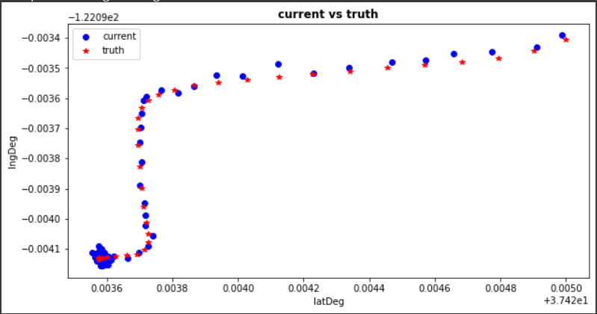
Results of Model 1
This model produced the following mean squared error for the longitude predictions
And produced the following mean squared error for the latitude predictions

Slide 14
Changes made for Model 2
In the second model, we tweaked the fit_intercept and normalize hyperparameters to be true so we can get a better prediction from the data.

Slide 15
Results of Model 2
These changes resulted in an even lower mean squared error:
Longitude Mean Squared Error:
a
Latitude Mean Squared Error
a

Slide 16

Obstacles
After examining the data, we had to choose what model we wanted to use because this is a very broad topic.
Another obstacle we had was data acquisition because we had trouble getting the ground truth data.
Notes:
After examining the data, we had to choose between learning models because of how broad our topic is, we chose linear regression models in order to see the best fit of truth data in comparison to current phone location.
We also had some trouble uncovering the truth data to compare the raw data to. Managing a large dataset is much more difficult than we had initially thought

Slide 17

Overcoming Obstacles
Extracting representative samples
Making sense of the samples
Finding the patterns to train and test our models towards
Managing conflicting time schedules
Notes:
To only call the google applied machine learning intensive, intensive would be our understatement of the summer but, these eight weeks have taught us more about machine learning than we could have imagined. While we may have completed our project, we faced struggles when trying to manage our very large dataset, as well as identifying patterns in the data for us to analyze. The raw dataset was over 30 gigs!

Slide 18

Lesson Learned
Understand the task at hand.
It’s okay to ask for help.
Understand your teammates’ strengths and weaknesses.
Communicate.
Notes:
When we first began our project, we misunderstood what our end goal was. We realized in order to work efficiently you need to find a good entry point but it easy for that same work to become meaningless with an incorrect or unclear target point as the aim.

Slide 19

Future Research
Our work has potential to be applied to:
Detection & Reporting of Potholes!
Finding Parking Spaces
Locating Lost Devices
Sharing Gift Ideas
Finding More Efficient Routes
Generating Day Travel Itineraries
Locating Landmarks over any mode of transportation

Slide 20
References
https://www.kaggle.com/c/google-smartphone-decimeter-challenge/overview
Data Set
https://policyadvice.net/insurance/insights/self-driving-car-statistics/
https://scikit-learn.org/stable/supervised_learning.html#supervised-learning
https://matplotlib.org/stable/api/_as_gen/matplotlib.pyplot.html
https://seaborn.pydata.org/
https://www.gps.gov/systems/gnss/

Slide 21
Questions?

